Slide 1
AI IN FINANCIAL SERVICES
DEFECT DETECTION FOR LAPTOPS
Industry Mentor
Manu Sharma
Hewlett Packard Enterprise(HPE)
Gayathri R 22i218
Vinithaa P 22z273
Kiruthika Sermadurai 22z336
Sanjitha R 22z259
Durga G 22z321
Academic Mentor
Dr.Suriya S
CSE Department
PSG College of Technology

Slide 2
Yolov8
Classes and their respective segmentation mask colour:
Crack (Red)
Lines (Yellow)
Others (Fades, Missing Keys, Broken hinges) (Blue)
Defectless (No mask)

Slide 3
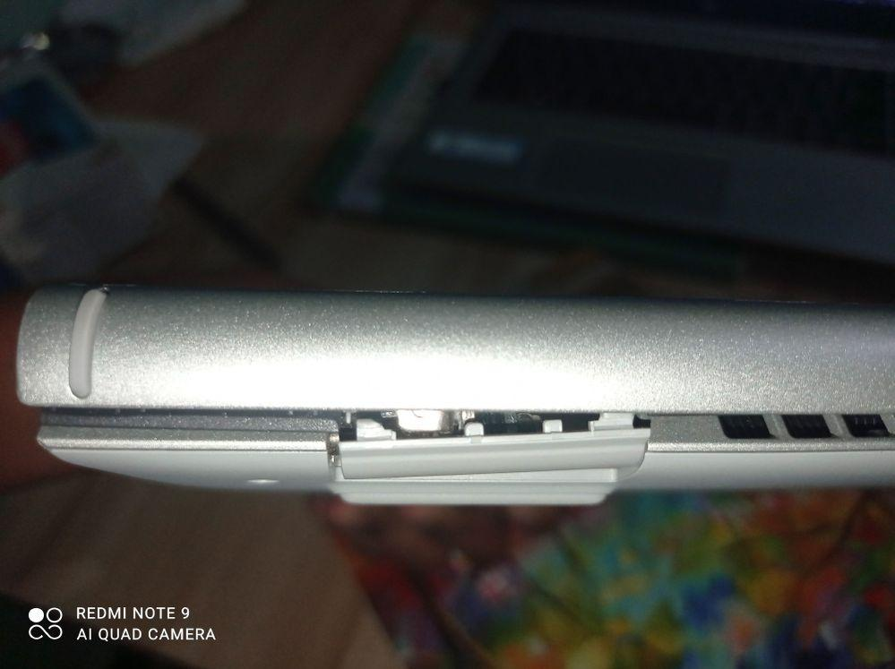
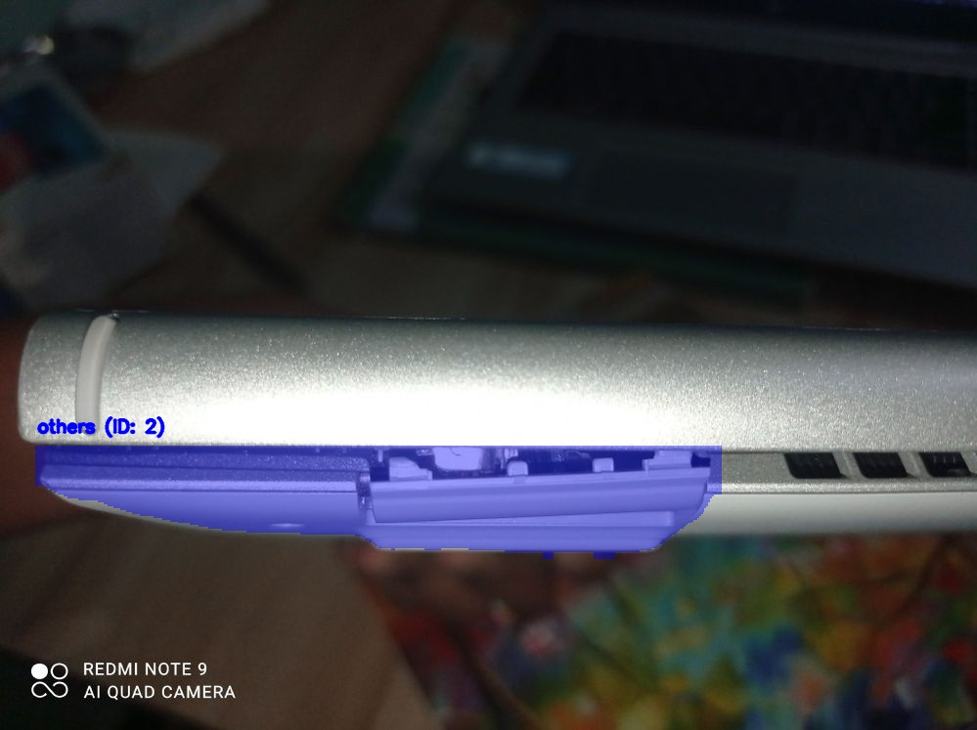
Yolov8- Defective laptops

Slide 4
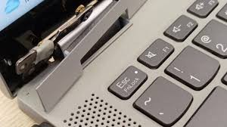
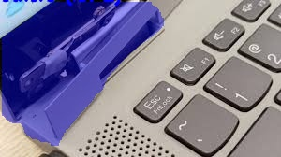
Yolov8- Defective laptops

Slide 5
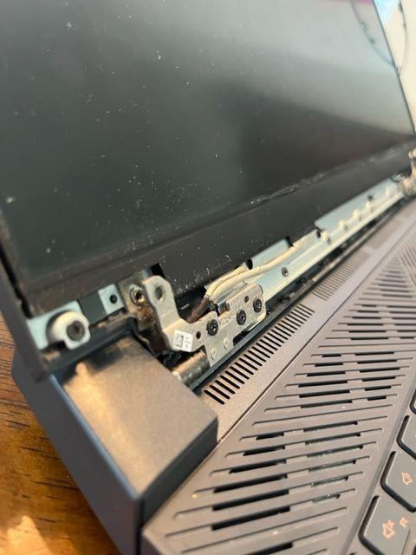
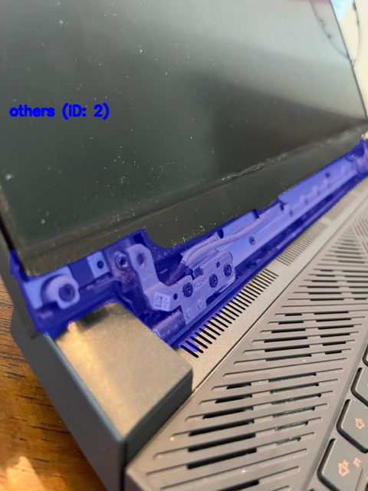
Yolov8- Defective laptops

Slide 6
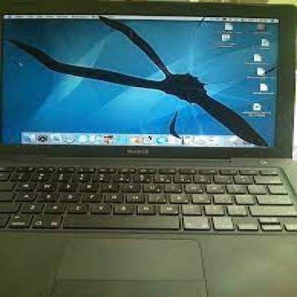
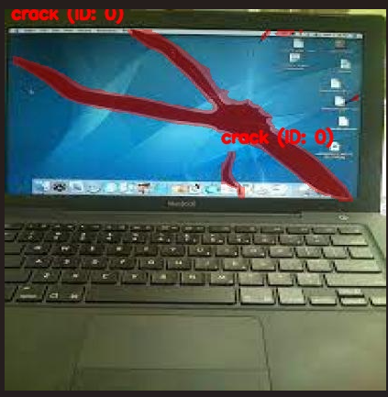
Yolov8- Defective laptops

Slide 7
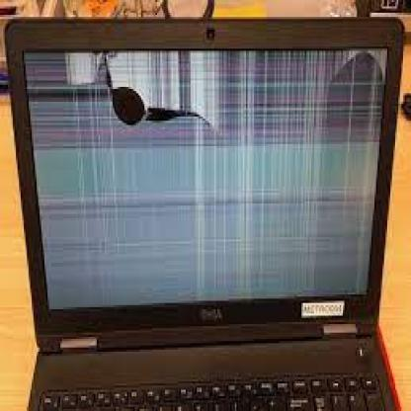
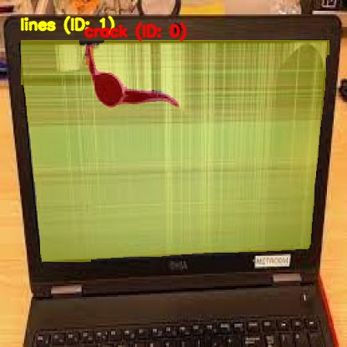
Yolov8- Defective laptops

Slide 8
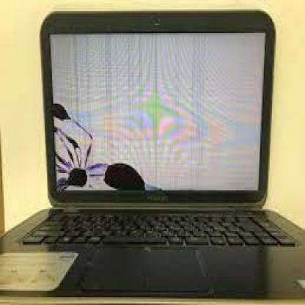
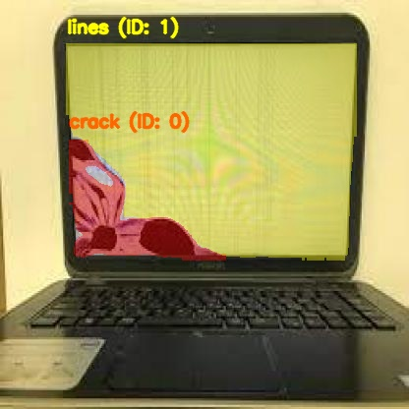
Yolov8- Defective laptops

Slide 9
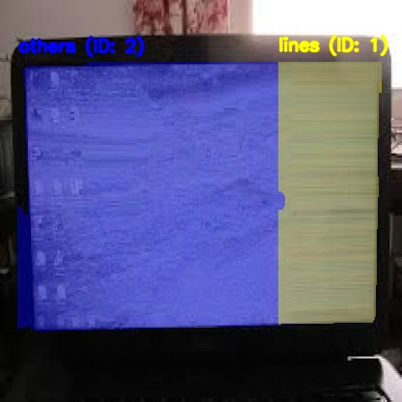
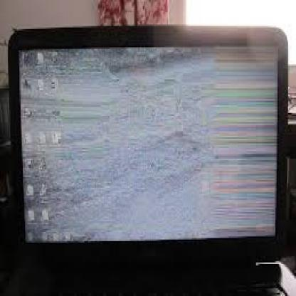
Yolov8- Defective laptops

Slide 10
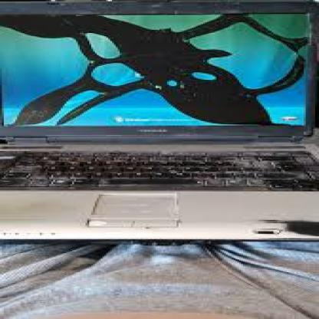
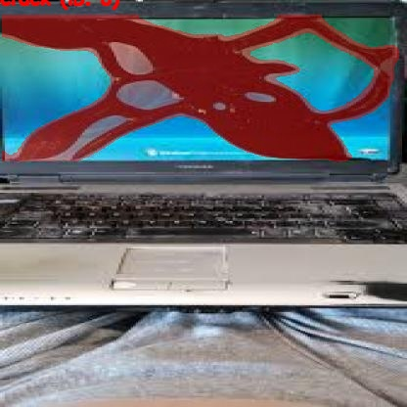
Yolov8- Defective laptops

Slide 11
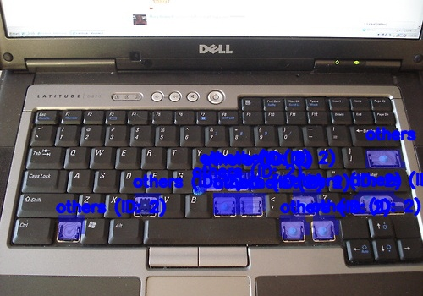
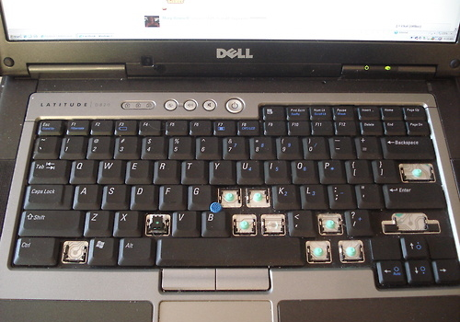
Yolov8- Defective laptops

Slide 12
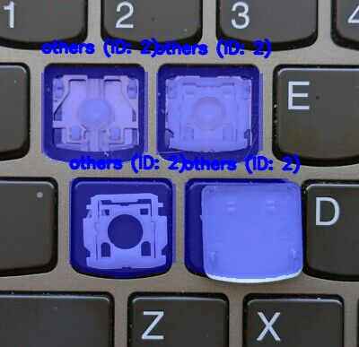
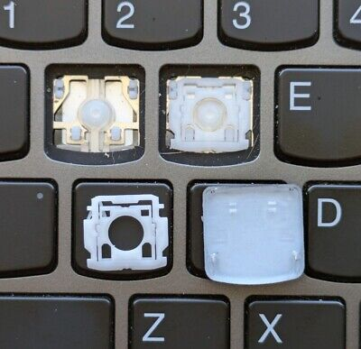
Yolov8- Defective laptops

